Slide 2
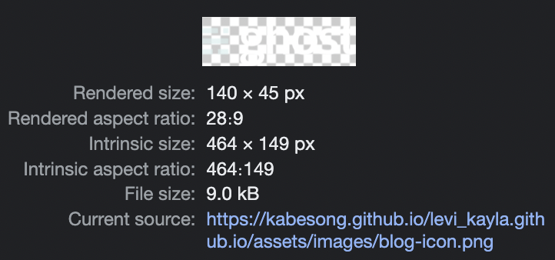

Levi + Kayla’
Levi +
Kayla’
$$\overline{Levi}+{Kayla}^{′}$$

Slide 3
Levi + Kayla'
Levi +
Kayla'
Talkeetna, AK
03.11.2023
Talkeetna, AK
03.11.2023

Slide 4
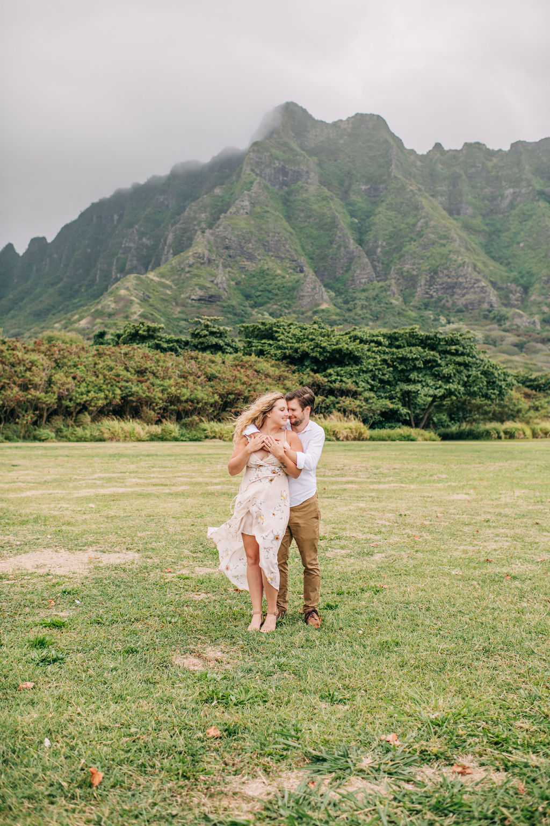
Levi + Kayla'
Talkeetna, AK
03.11.2023

Slide 5
Levi +
Kayla’
Levi + Kayla’
Levi +
Kayla’

Slide 6
Levi + Kayla'
Levi +
Kayla'
Talkeetna, AK
03.11.2023
Talkeetna, AK
03.11.2023

Slide 7

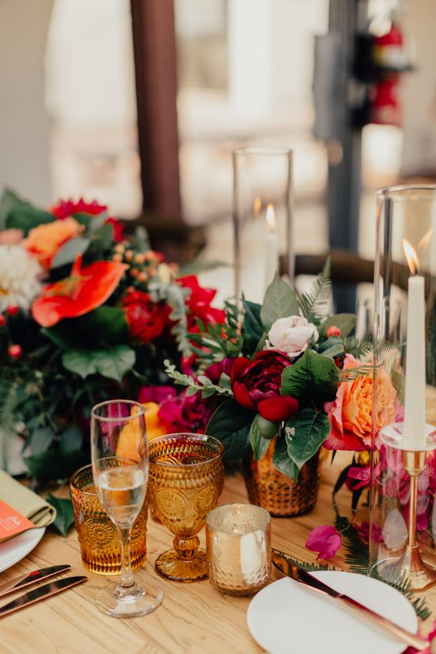
PINE
ORAGNE
CRANBERRY

Slide 8
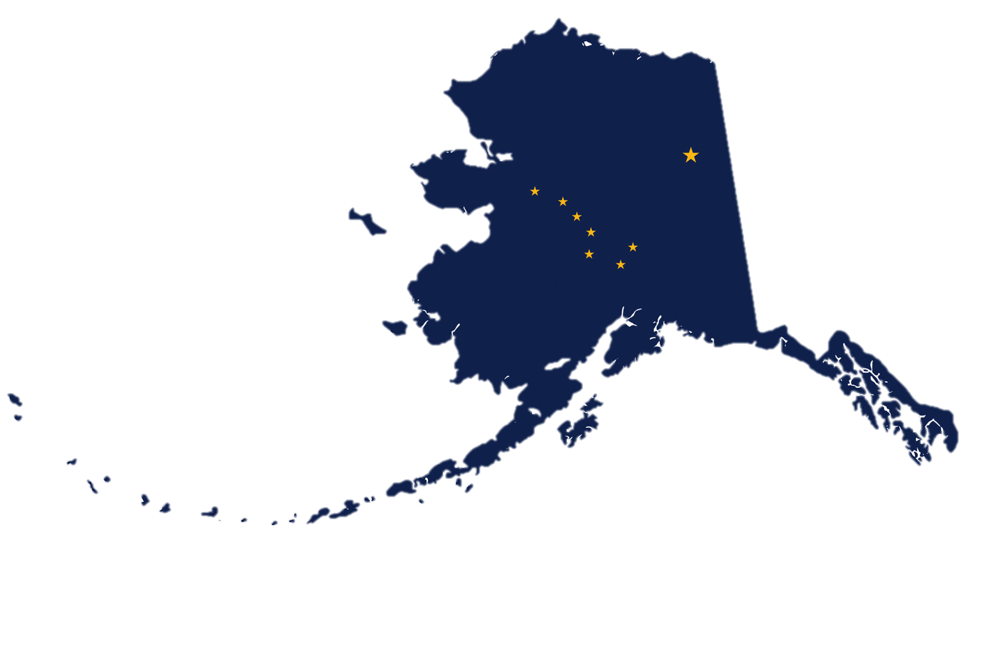

Slide 9
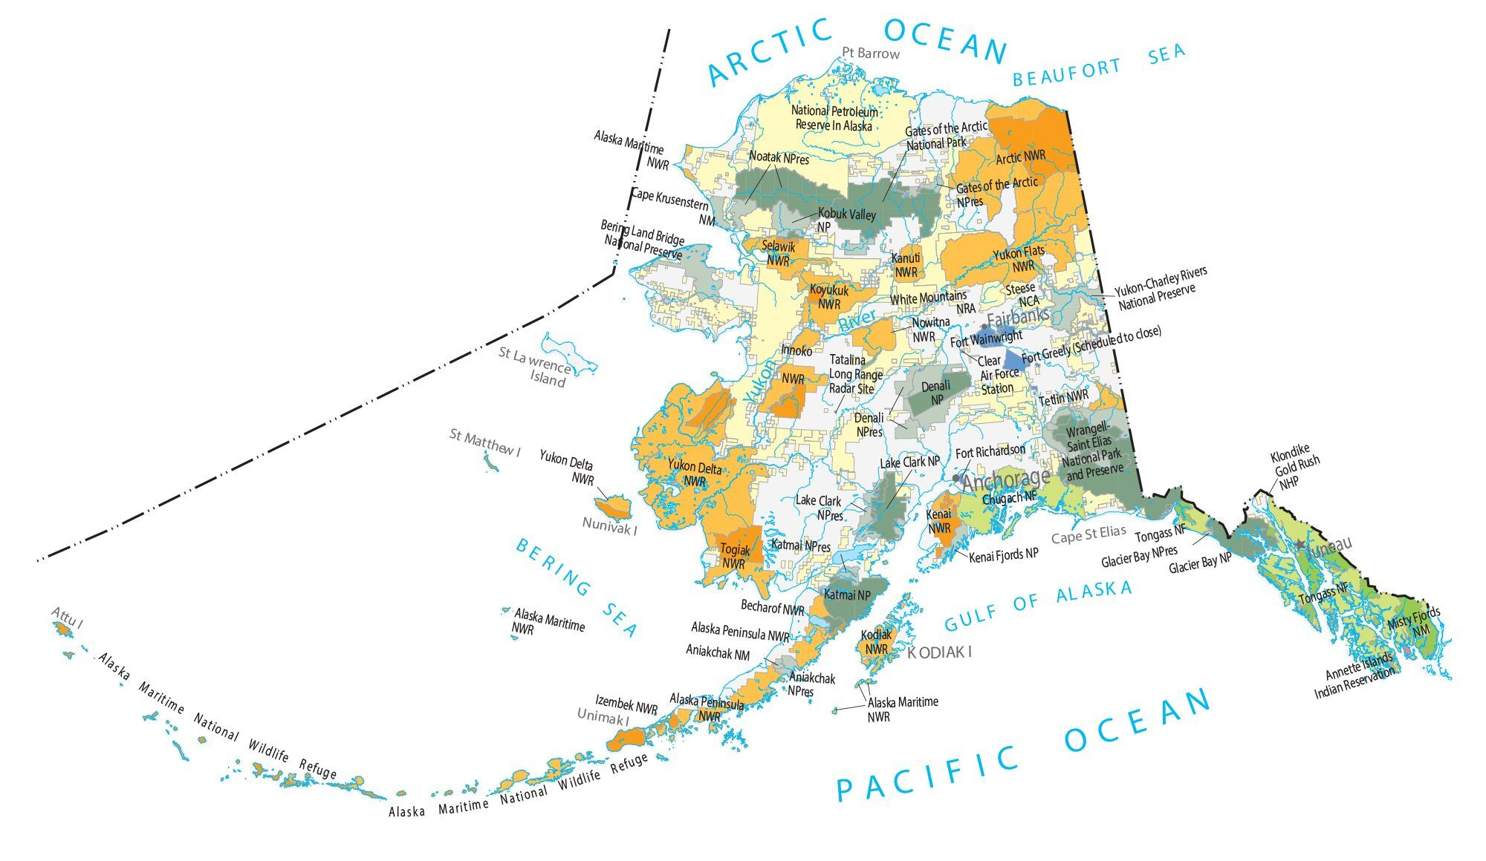

Slide 10
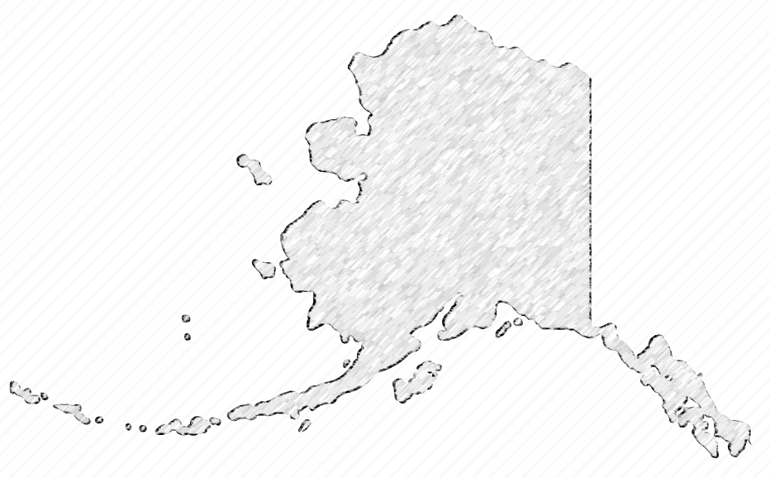




Slide 11
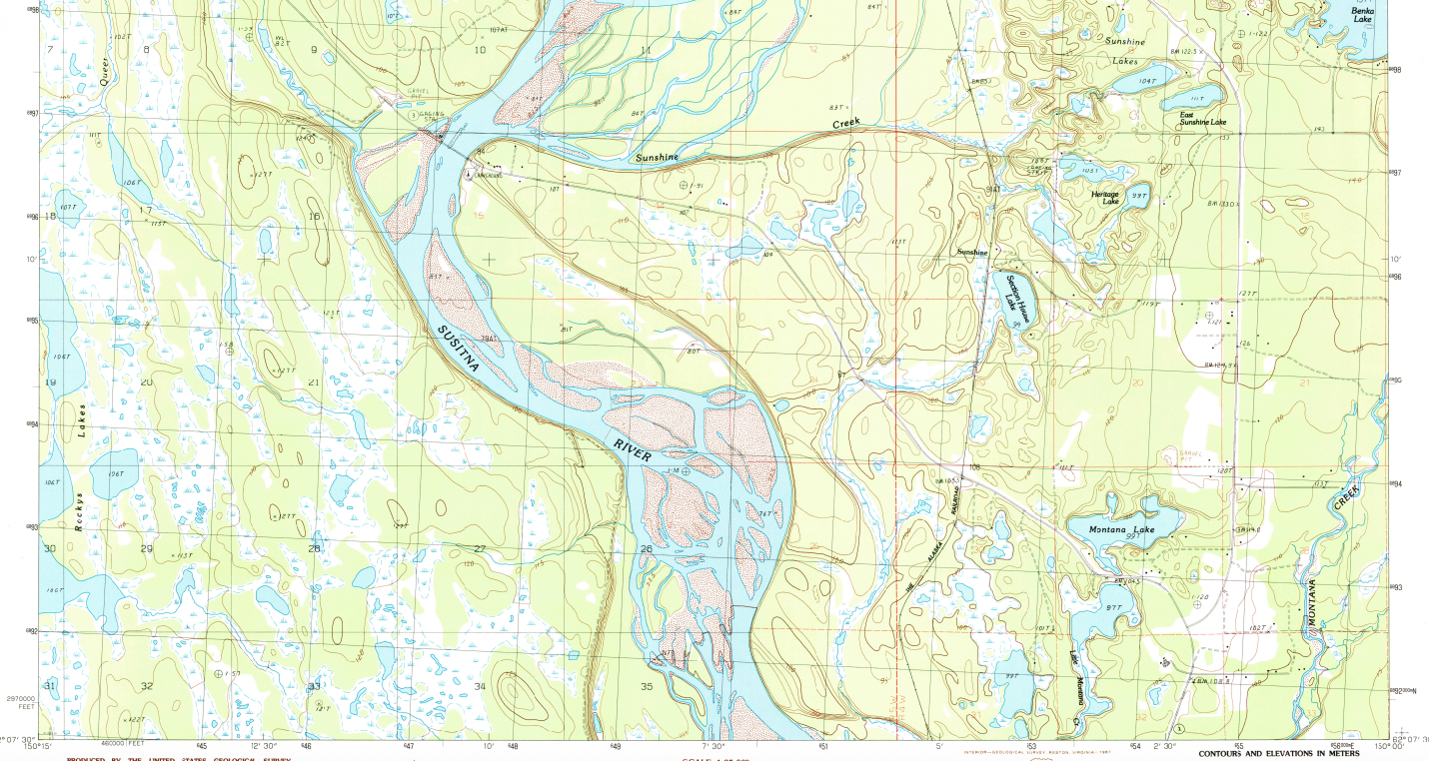

Slide 12
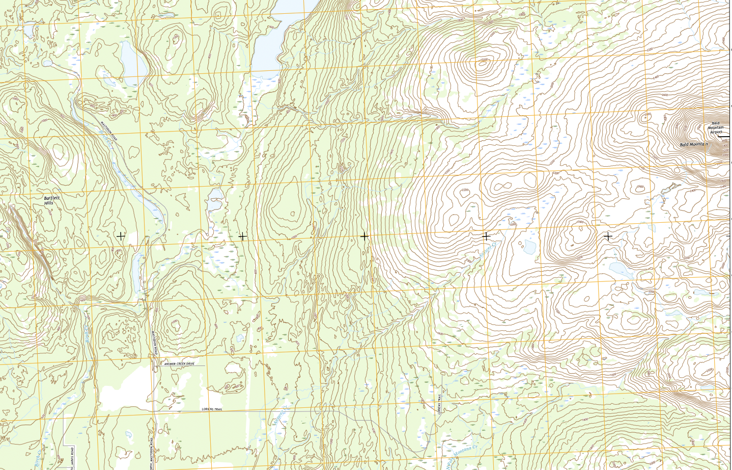

Slide 14



Slide 15



Slide 16
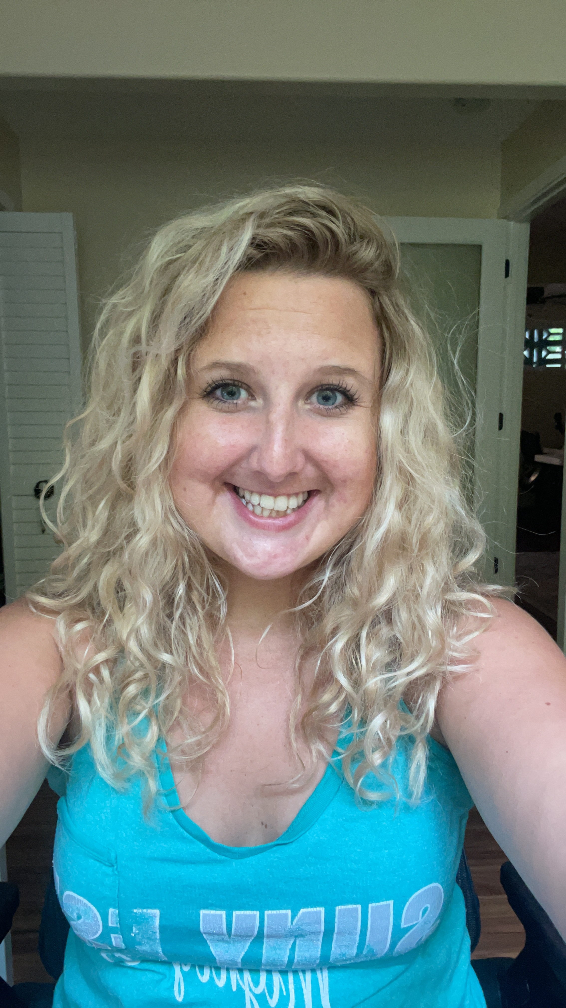
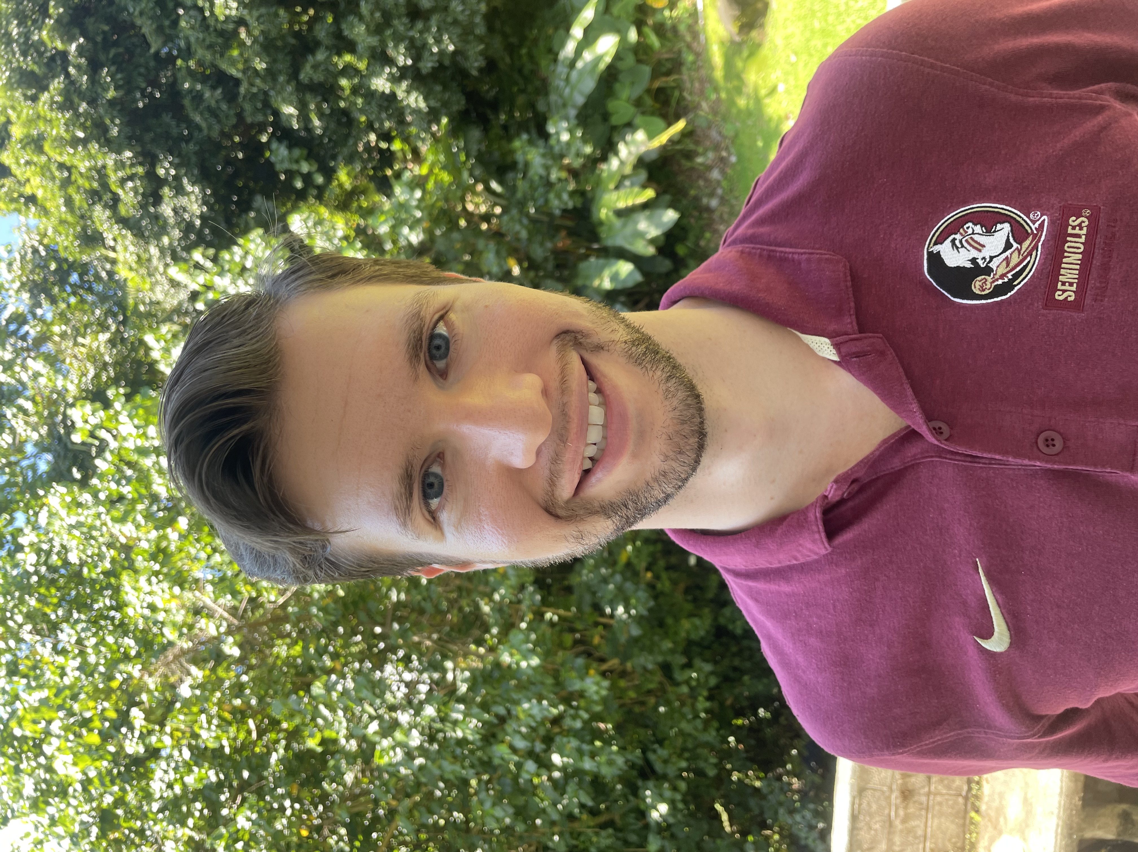
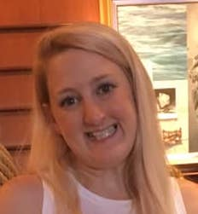
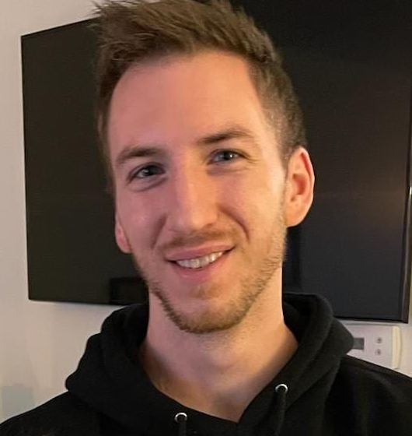
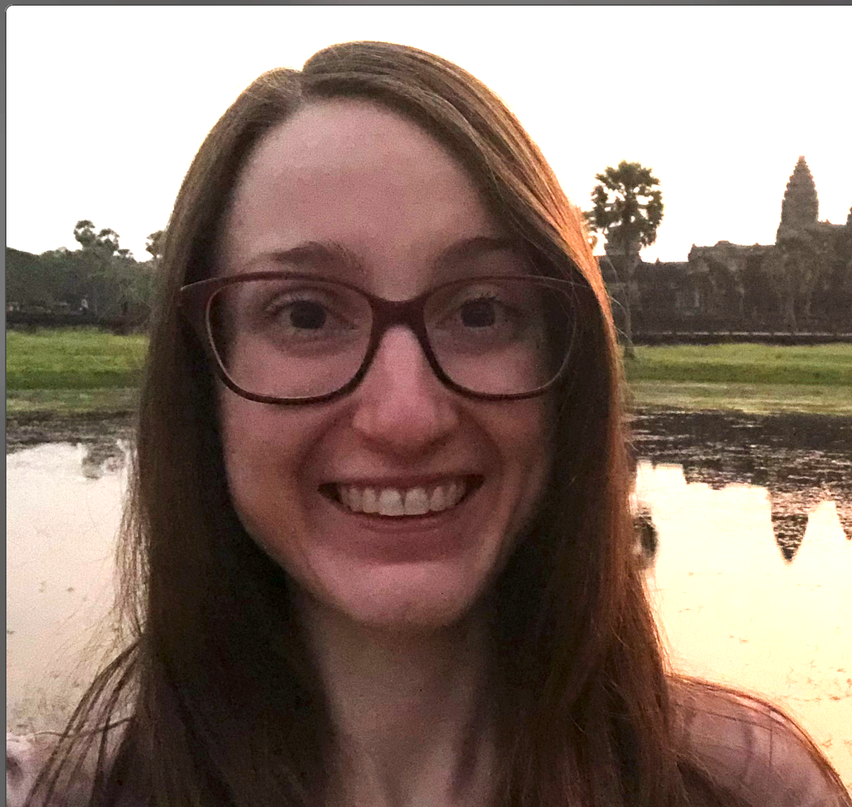
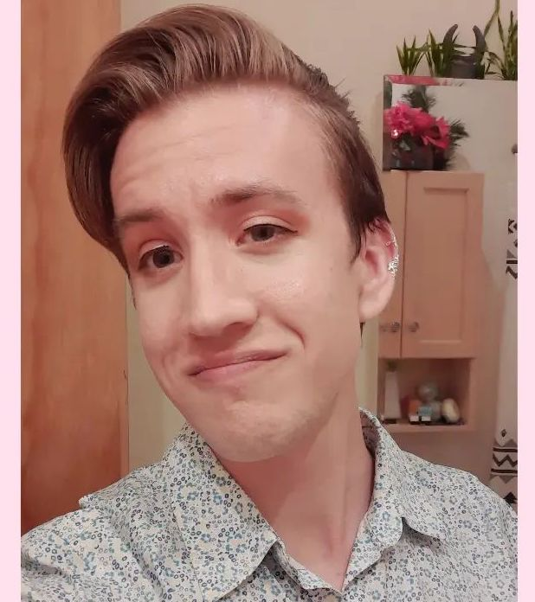
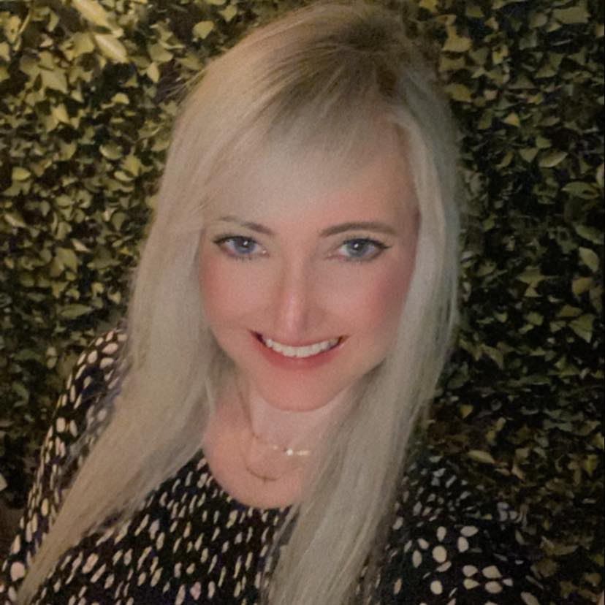
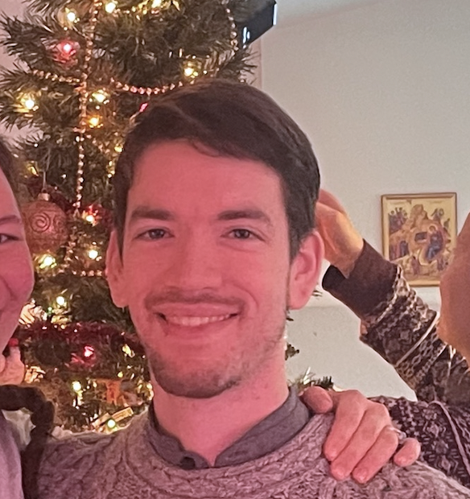

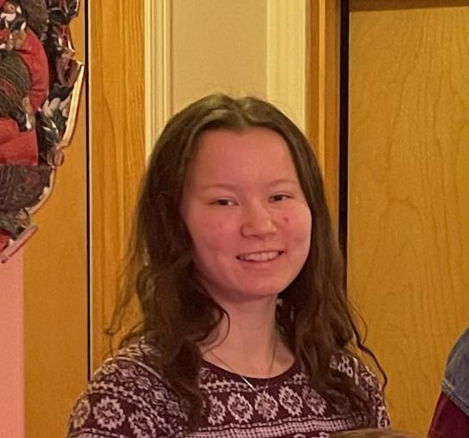
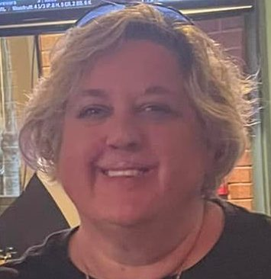
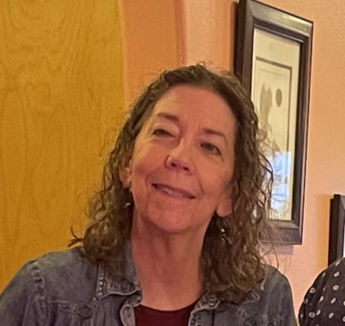
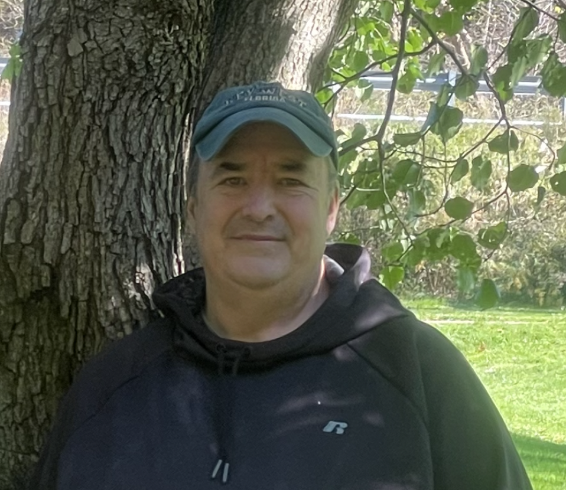
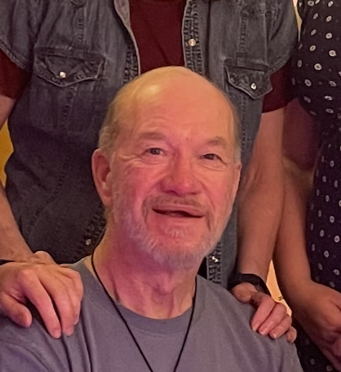
Kayla Besong
Levi Cowan
Bride
Groom
Jenna Besong
Lance Cowan
Matron of Honor
Sister of Bride
Ft. Lauderdale, FL
Best Man
Brother of Groom
Bloomington, IN
Ashley Hileman
Reece Cowan
Cousin of Bride
Pittsburgh, PA
Brother of Groom
Los Angeles,, CA
Rhonda Neish
Cyrus Cowan
Cousin of Bride
Ft. Lauderdale, FL
Brother of Groom
Seattle, WA
Haley Rippee
Lilly Cowan
Cousin of Bride
Pittsburgh, PA
Sister of Groom
Homer, AK
Joyce Rippee
Chelsea Cowan
Mother of Bride
Pittsburgh, PA
Mother of Groom
Homer, AK
Michael Besong
John Cowan
Father Of bride
Pittsburgh, PA
Father of Groom
Homer, AK

Slide 17
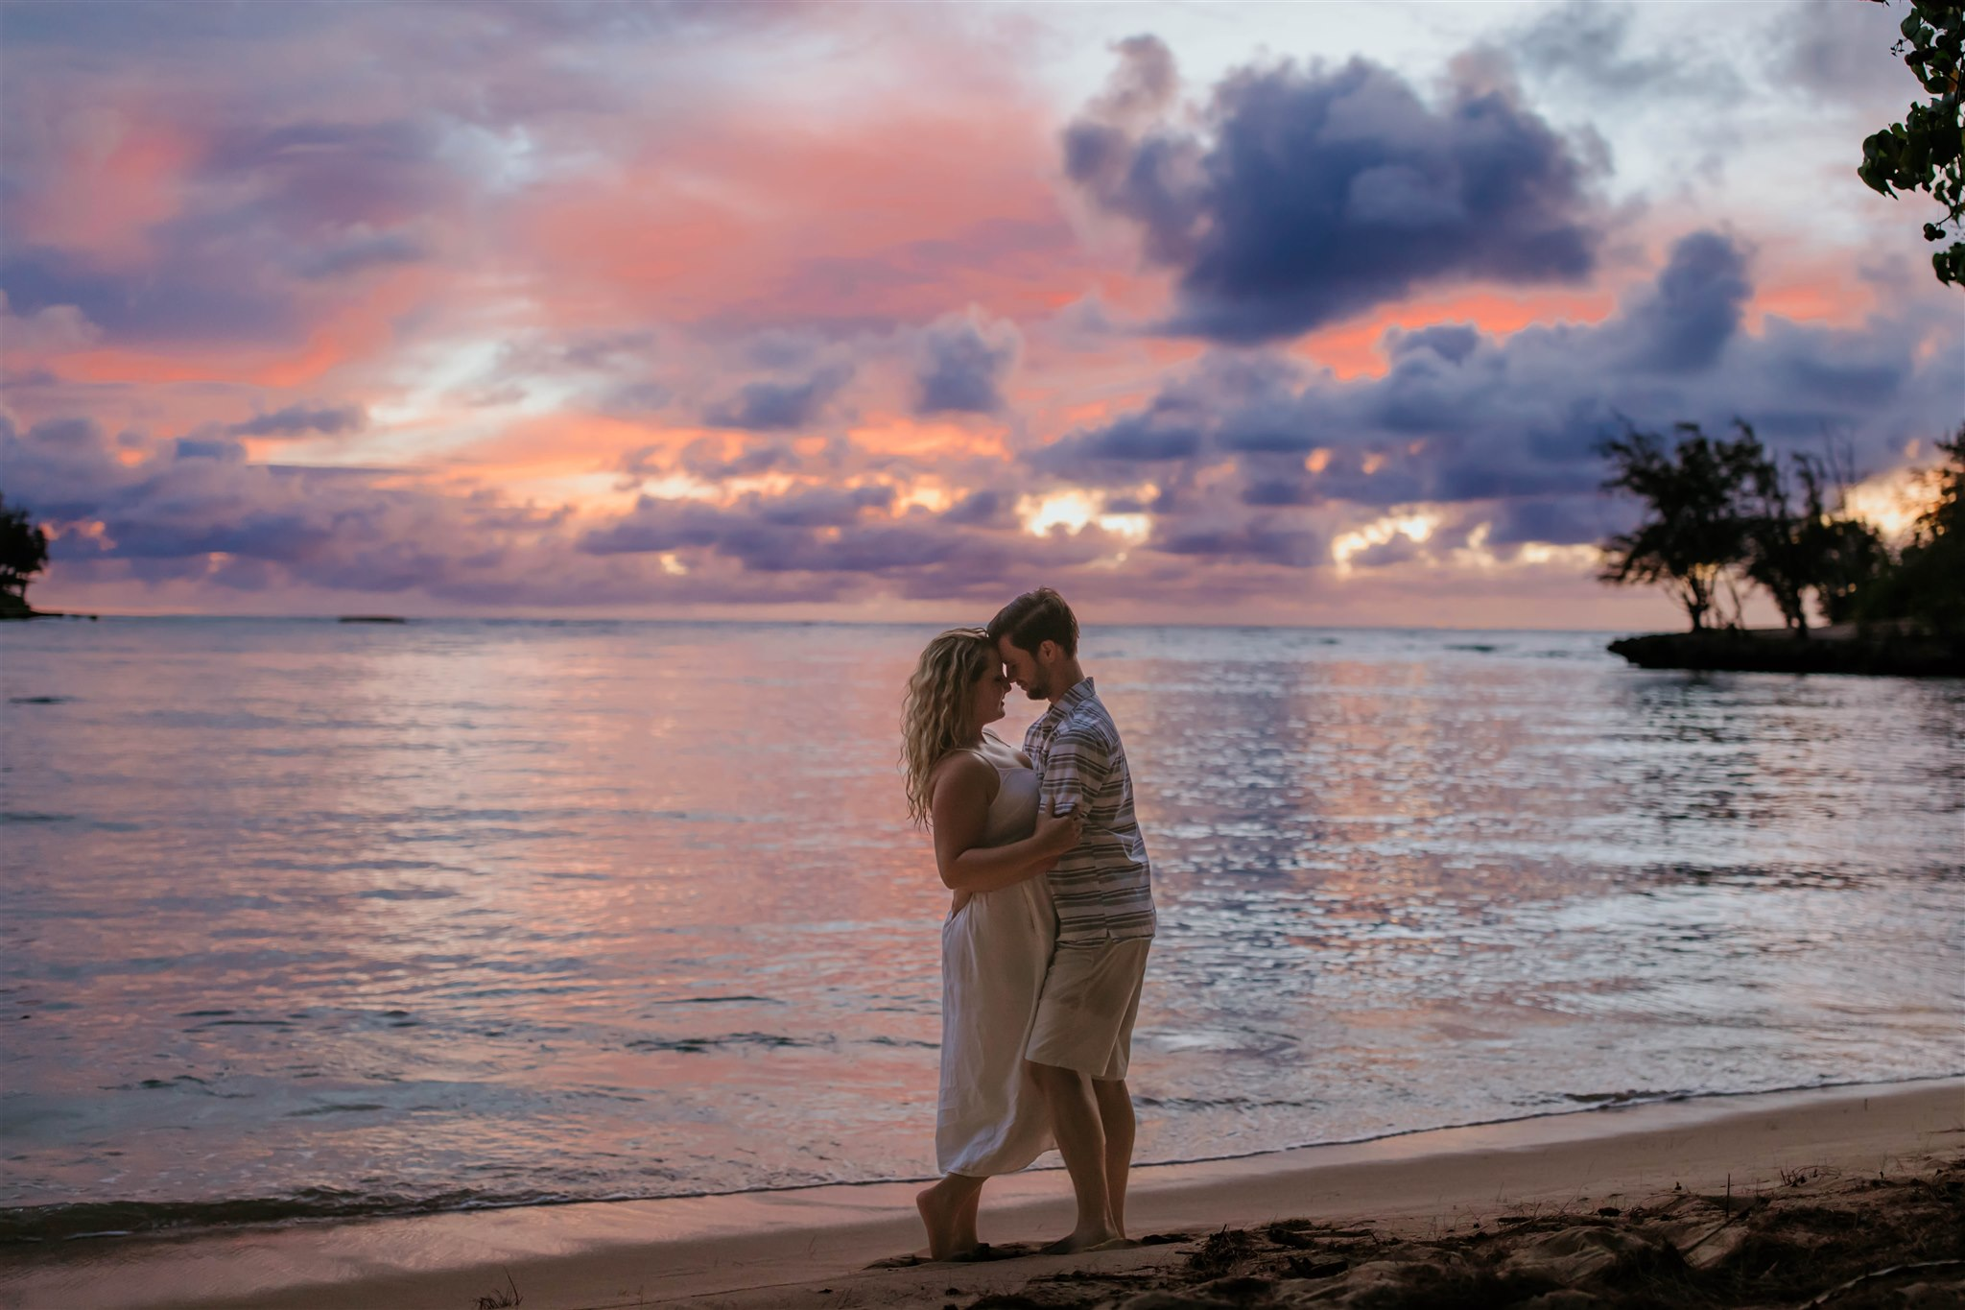

Meet the Wedding Party
Kayla Besong
Levi Cowan
Bride
Groom
COMING SOON

